Slide 1
Scope Functions in Kotlin
{ }
Scope

Slide 2
Scope functions?
Kotlin standard library has extension functions that execute a block of code on Object and they provide a scope using lambda expression that’s why they are called Scope Functions.
Types
let
run
with
apply
also
{ }
Let
run
with
apply
also
Function scope
e.g object.let { //logic
}

Slide 3
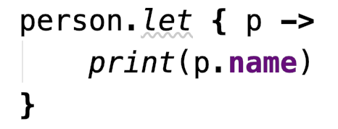

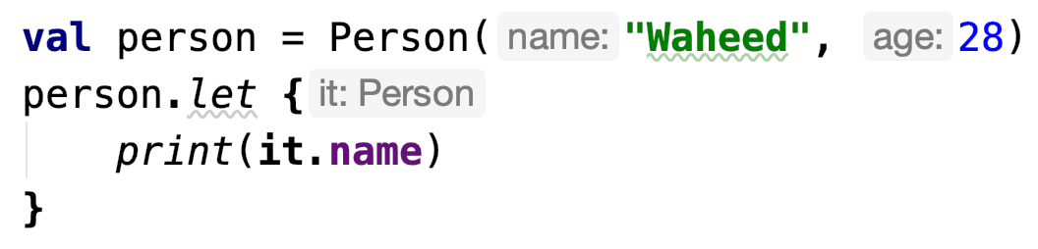
let is mostly used for these scenarios
To perform actions on non null object using safe call operator ?.
Multiple functions calls as chain
Helps to create local variable with limited scope in lambda
Transformation: Let can return anything from object
OR: You can create a local variable in lambda scope
😉 It’s easy
Person data class
👉 it
(You’ll receive calling object as it inside this scope)
Person object
👉 this
You can access class instance as this
Accessing object properties using let
👱🏻‍♂️
{ }
let
it: Person
this (Reference of class)
print(it.name)
Output: Waheed

Slide 4
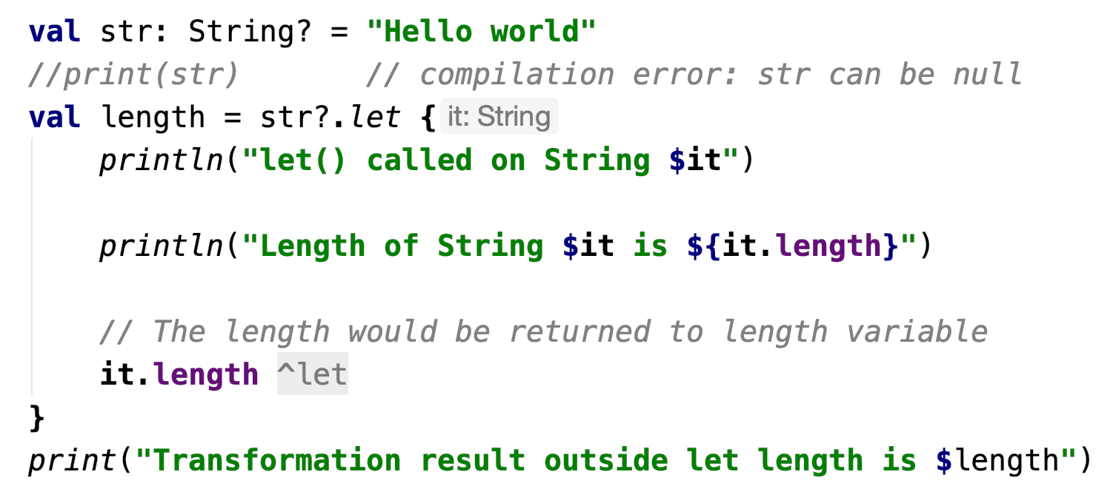
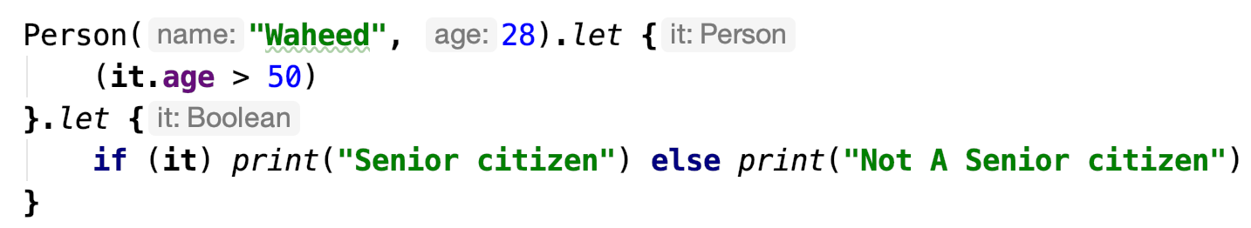
Let on non null objects using safe call operator ?.
Creating variable from Transformation
String variable that can hold null value
Example: Non null check, Transformation, Creating variable
Example: Null check
val str: String? = null str?.let { // Wouldn’t execute because str object is null print(it) } // No output
Transformation: Creating length variable, passed from here
Safe Call operator
Transformation: Chain of calls using let
Applying condition on one property of object and handling result using let.

Slide 5

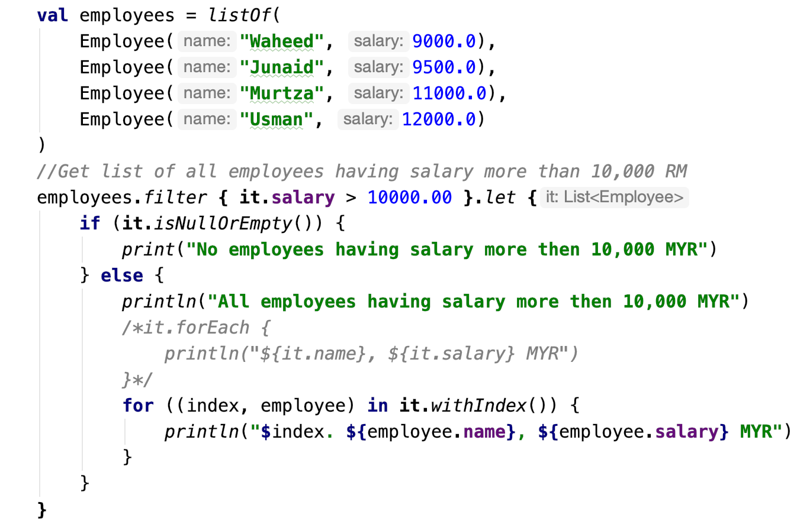
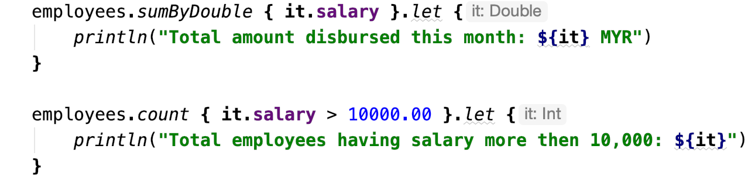
Let examples:
-:Use case:- operations on Employees data e.g. filter, check salaries, total amount paid
Employee Data class
List of employees
Predicate/logic to filter data
You’ll get filter list here in it
👇
More operations on employees list
Find total sum of all employee salaries or Total salary amount disbursed
👇🏽
For each loop, to iterate employees
For loop with index to iterate filtered list of employees
Count all employees having salary more then 10,000 MYR
Notes:
Let, Run are “transformational” functions. They’re called "transformational" because the object they return can be different from the object you call the function on.

Slide 6
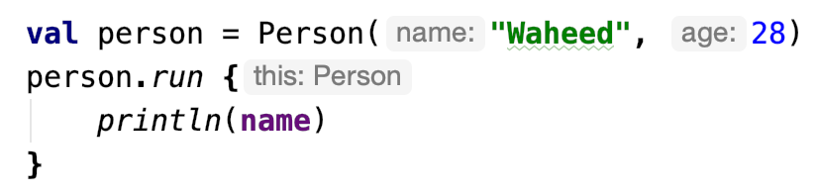
run is almost same like let, but it is more focused on target object
To perform actions on non null object using safe call operator ?.
Multiple functions calls as chain
Transformation: Run can return anything from object
Doesn’t allow to create a local variable in lambda scope
You cannot create a local variable in lambda scope
Person data class
Person object
👉 this
(You’ll receive calling object as this inside run scope and you can directly call properties of object or using this)
Accessing object’s properties using run
👱🏻‍♂️
{ }
run
this: Person
print(this.name) OR
Print(name)
Output: Waheed

Slide 7
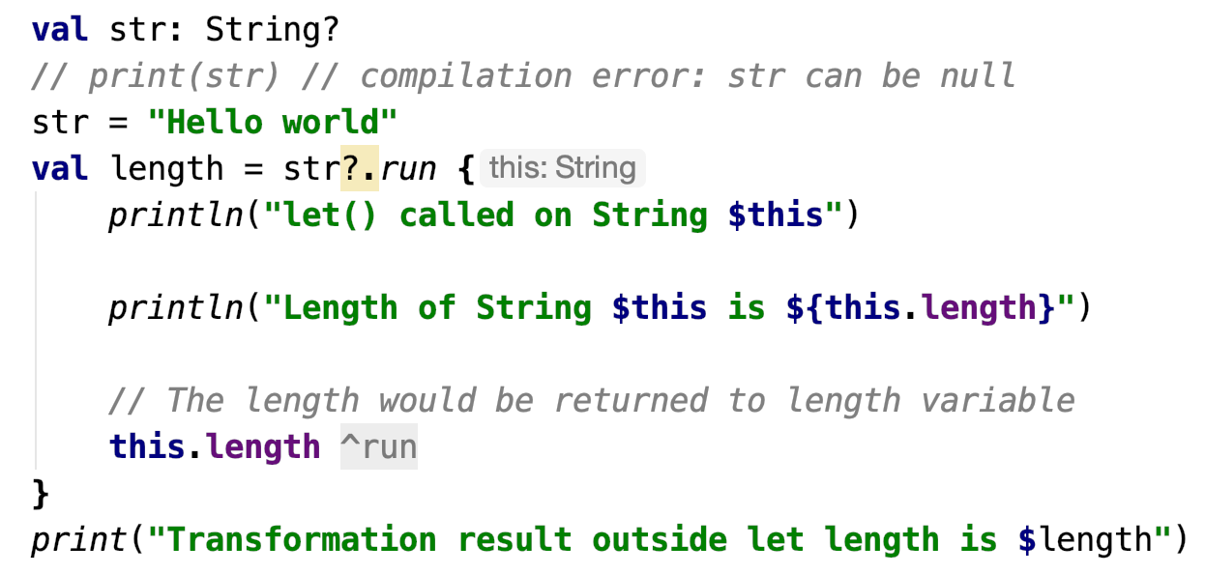
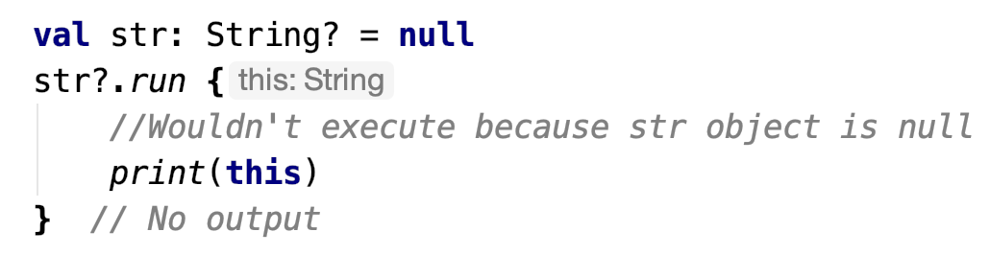
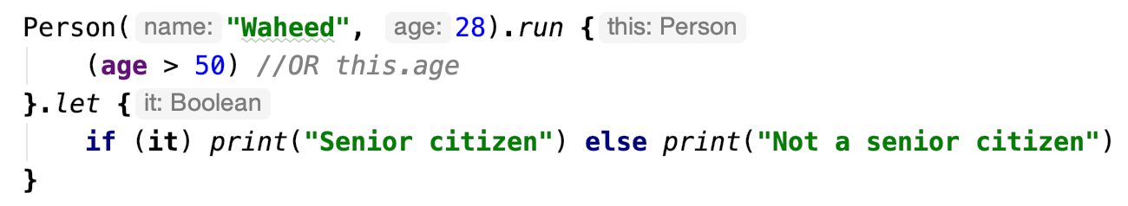
Run on non null objects using safe call operator ?.
Creating variable from Transformation
String variable that can hold null value
Example: Non null check, Transformation, Creating variable
Example: Null check
Transformation: Creating length variable, passed from here
Safe Call operator
Transformation: Chain of calls using run
Applying condition on one property of object and handling result using run.

Slide 8
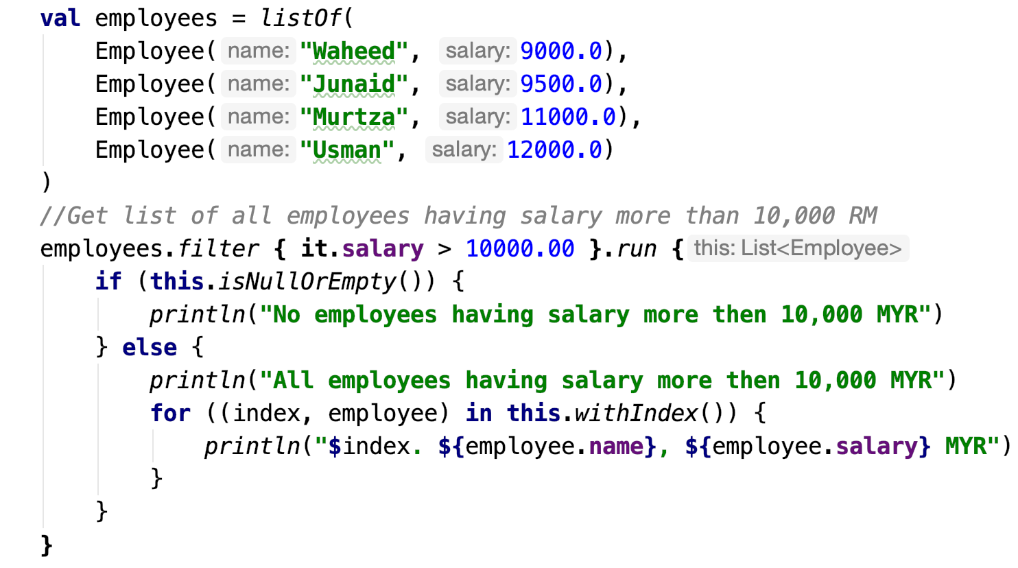
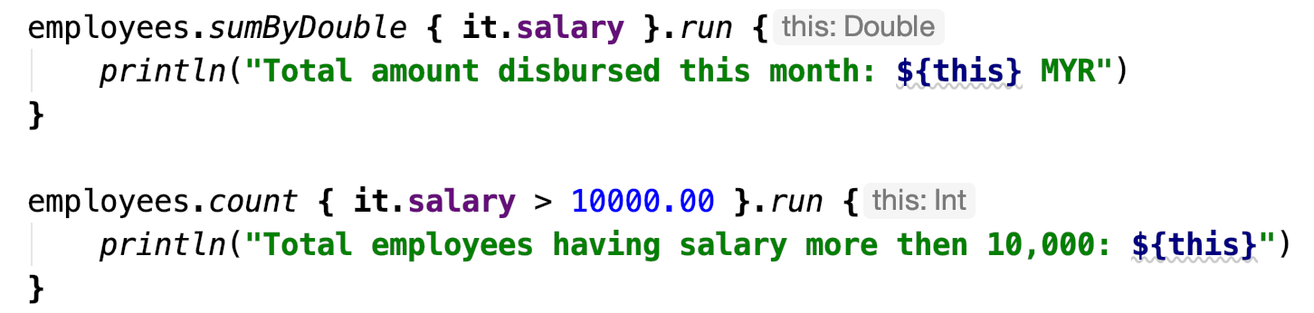
Run examples:
-:Use case:- operations on Employees data e.g. filter, check salaries, total amount paid
Employee Data class
You’ll get filter list here in it
👇
More operations on employees list
Find total sum of all employee salaries or Total salary amount disbursed
👇🏽
For loop with index to iterate filtered list of employees
Count all employees having salary more then 10,000 MYR
Notes:
Let, Run are “transformational” functions. They’re called "transformational" because the object they return can be different from the object you call the function on.

Slide 9
also is mostly used for these scenarios
To perform actions on non null object using safe call operator ?.
Multiple functions calls as chain
Helps to create local variable with limited scope in lambda
It returns original object instead of transformation
OR: You can create a local variable in lambda scope
😉 It’s easy
Person data class
👉 it
(You’ll receive calling object as it inside this scope)
Person object
👉 this
You can access class instance as this
Accessing object properties using let
👱🏻‍♂️
{ }
let
it: Person
this (Reference of class)
print(it.name)
Output: Waheed

Slide 10
Comparison Table:
Function | Object reference | Return value | Is extension function?
let | it | Lambda result | Yes
also | it | Context object | Yes
run | this | Lambda result | Yes
apply | this | Context object | Yes
with | this | Lambda result | No
Reference, more details

Slide 11
Cheat-sheet: Jose Alcérreca (Maker & Developer Programs Engineer @ Google – Android)
https://medium.com/androiddevelopers/kotlin-standard-functions-cheat-sheet-27f032dd4326

Slide 12
Cheat-sheet: Jose Alcérreca (Maker & Developer Programs Engineer @ Google – Android)
https://medium.com/androiddevelopers/kotlin-standard-functions-cheat-sheet-27f032dd4326

Slide 13
References:
https://kotlinlang.org/docs/reference/scope-functions.html
https://medium.com/androiddevelopers/kotlin-standard-functions-cheat-sheet-27f032dd4326
https://twitter.com/ppvi/status/1081168598813601793/photo/1
https://kotlinlang.org/docs/reference/functions.html
https://www.journaldev.com/19467/kotlin-let-run-also-apply-with

